Slide 1
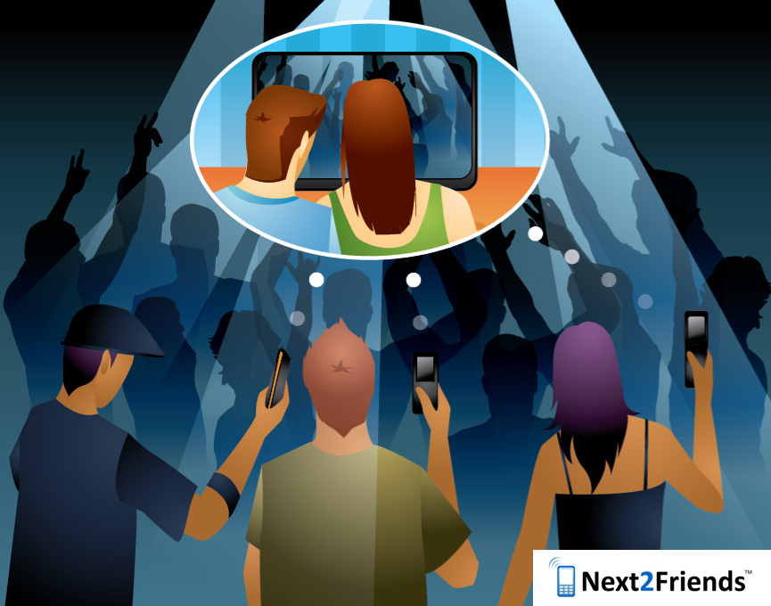
The Mobile Social Media Platform
Corporate Presentation to XXX (recipient) on XXX (date)
This document is private and confidential and not to be copied, distributed, stored, duplicated or transmitted without the express written permission of the Directors of Next2Friends Ltd and is for information purposes only. The Directors of Next2Friends Ltd make no warranties, express or implied, as to the information in this document. The Directors of Next2Friends Ltd may have patents, patent applications, trademarks, copyrights or other intellectual property rights covering subject matter in this document, the furnishing of which does not give the recipient any license to these patents, trademarks, copyrights, or other intellectual property. For further information visit www.next2friends.com or email contact@next2friends.com

Slide 2
Agenda
Next2Friends Background
Market Size and Opportunity to Work Together
The Next2Friends Team
Contact Information

Slide 3
Introduction and Background
UK Ltd Company est. 2007
Multi-location business:
Research and Development based in Minneapolis + Off Shore
Sales and Account Management in NYC
Sales, Finance and Legal Admin Based in UK
9 month beta phase Jan –Sept 08
Already revenue generating via multi-channel business model
Patent-pending technology
Built on friends & family, sweat equity & capital, now with the help of Simon Property Group www.simon.com and DropJaw Ventures

Slide 4
Introduction and Background
Successes to Date
Attracting visitors from 144 different countries with registered users from + 100 countries through mostly pure viral growth
Awarded Web Designer Magazine Hot 100, Always On Global 250 (2008)
Serves +40,000 page views per day, global Alexa ranking of 94,871 (Aug 08)
Attracted 25 talented members of staff and management
Made first acquisition of Bluetooth Meet, two additional deals planned for Q3 2008
Early ‘Super Users’ actively driving traction and traffic

Slide 5
Problems Solved, Opportunities Created
Provides unique blend of on-demand, mobile-based real-time services to network of family and friends:
Real-time video streaming
Real-time photo capture and upload
Location and profile-based messaging and target marketing
Bluetooth tagging for location-based networking
Social shopping and opinion gathering
Provides compelling, well-defined and captive audiences for push and location-based marketing to mobiles
Provides mobile content delivery capability for media and other companies to stream content in real-time to the mobile device

Slide 6
Opportunities Created
Retention of loyal customers with location aware messaging and other experience improvement tools:
Most wireless networks need more sticky, real-time value-added mobile and internet services
Retailers seek to ‘touch’ consumers in real-time by offering promotions based on proximity and profile
Interactive Marketing Services (IMS) for advertising & new media agencies
Real-time mobile broadcasting & opinion gathering for corporate communications
Improved content & data ARPU for wireless operators:
Real-time video streaming/photo upload from the mobile handset
Drive new handset sales and subscriber acquisition at lower costs
Increased subscriber retention at lower customer care costs
Why lose ARPU to a broadband service for post event upload via PC?
How to work with Next2Friends:
Pre-install Lite Java Apps on mobile handsets or via your site
Co-market to users and partners
Revenue share models, no large capital expense

Slide 7
Core Values
Connected consumers, fans to artists, virtual to real, mobile to PC, behaviour to technology, staff & business units, brands to customers, people to phones, technology to life, suite of services, global to local
Compelling partnership target, content that drives traffic and use, business proposition, relevant and required features, brand and marketing activity, unique offering, influential, smart
Accessible to all, content and services, around the world, ‘people business’, open community, simple, real-world, networked, supportive, easy, friendly, integrated, sharable, compatible, collaborative, social

Slide 8
Real-time Media Streaming
Location Based & Auto Ad Injection

Slide 9
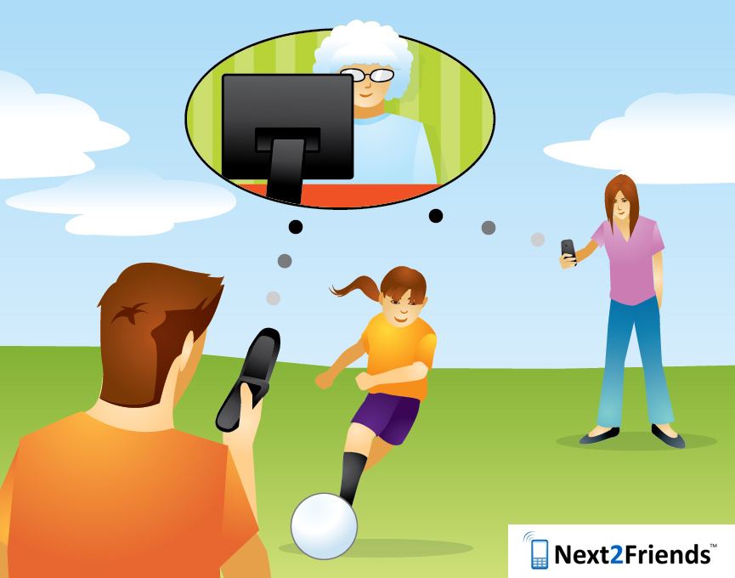
Real-time Photo Upload
Auto Ad Injection

Slide 10

Intelligent Bluetooth Tagging
Location Based Ad Injection

Slide 11

Mobile Sat Nav - Street View
Location Based Ad Injection

Slide 12

Ask
(Social Shopping)
Location Based & Auto Ad Injection

Slide 13


Core Audiences & Feature Map
Teen & Tween
Family / Female
Techie / Male
Video Comms
Snap Up
Tag & Meet
Sports & Showbiz
Ask
Social Shoppers
Live
Social Networking
Mommy, Daddy & Me

Slide 14
The State of Social Networking
Social Networks are on the cusp of a mobile revolution.
Traditional social networks are just emulating PC services in a mobile browser. This is not integrated, relevant or truly innovative.
Data, not SMS or even MMS, leads the revolution… the “twitters” of the world can only last so long.
The mobile device will be as powerful as the PC. It is immediately more pervasive and ‘in-the-pocket’. Mobile devices are the closest any digitally marketable product can get to consumers.
Next2Friends is the integration of mobile services that enhances the virtual social experience with real life, adding intrinsic value for the user and a reason to engage.
Next2Friends creates a social network that becomes a tool to capture and share what happens in the world we walk in, not just the world we play in.

Slide 15
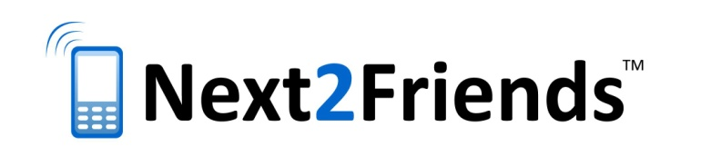
Mobile Social Networks & Advertising
12.3 million consumers across US and Europe accessed a social network site through their mobile in June 2007 (M:Metrics)
600 million Social Network members will drive UGC revenues to approx. $5.7 billion by 2012 (Juniper Research)
Mobile advertising using rich media formats is predicted to reach $2.79bn (£1.41bn) globally by 2012 (Screen Digest)
Around $500m (£253m) of the total will be generated in Europe with the bulk of revenues coming from Japan and South Korea.
Almost 3 billion mobile coupons will be issued to mobile users by 2011, with just under $7 billion of discounts redeemed (Juniper Research)
64% of 18-20 year olds / 51% of 18-35 year olds are willing to act as a proactive brand advocates on social networks in exchange for offers and discounts. (Tamar/YouGov 2007)

Slide 16
Smartphone Usage Trends
Notes:
Pricing opening up the pipe
We believe the lower price points for data usage should drive adoption. We note that text messaging packages actually start at $5 per month depending on usage, while mobile internet access (unlimited) prices at ~$15 per month. In addition, unlimited $99 voice plans from Sprint and T-Mobile include unlimited text (and data from Sprint).
iPhone proves that handsets are key in driving the customer experience
We expect smartphones to improve the customer experience and drive significant data adoption uptake. We expect smartphones to account for 40% of handsets sold in North America by 2012, up from roughly 11% today (see Exhibit 8). We believe the rapid iPhone adoption highlights the demand for more powerful, intuitive devices. We note that at our recent Goldman Sachs Tech Symposium in February, Apple reaffirmed that the company is on track to meet its 10mn iPhone unit sales target for calendar 2008.
While we expect those shipments to be more backend-loaded, we continue to look for 11 million units for the year.
Interoperability slowly improving, likely through market share consolidation
One of the biggest barriers to mobile data adoption has been the lack of common operating systems and middleware in devices – today, mobile content developers need to make several hundred versions of each game, ringtone, etc. given the multiple standards used by almost every handset vendor. For example, Nokia has Series 40 phones with a proprietary operating system, as well as its Symbian O/S-based Series 60 phones and a few Linux-based models. Motorola uses several versions of its own proprietary O/S as well as making Microsoft-based, Linux-based, and Symbian/UIQ-based products. In Japan, the success of mobile data reflects the determination by DoCoMo and KDDI to enforce the use of common O/S and interfaces on handset vendors.
Moving forward we expect the market to concentrate around a small number of platforms (Symbian, Windows Mobile and
potentially Apple, Blackberry, BREW and Linux), driven by natural market share consolidation as barriers to entry in smartphones are high and few existing handset vendors will be able to afford the investment required. Greater operator discipline in handset selection will also be important. In addition, from the network side interoperability will be enhanced by the development of the IP Multimedia Subsystem (‘IMS’) standard, a common SIP-based architecture for delivering multimedia services across both fixed and mobile networks.
Content and applications likely to improve dramatically once key gating factors are overcome
We expect the availability of attractive, easy to use and interoperable devices combined with affordable high-speed networks will finally kick-start the development of compelling mobile content and applications, offering far greater choice and quality than the ringtones, basic games and text-based services (e.g., horoscopes, etc.) available to users today. In addition to paying for Internet access we expect wireless users to adopt existing ‘wired’ Internet services such as web-browsing, search, email, music, instant messaging and social networking in large numbers, and also anticipate growth in new context-based services (e.g., navigation and location based search), rich multimedia content (e.g., games, videos) and a host of enterprise applications (e.g., machine-to-machine communications).

Slide 17
Estimated Growth of Mobile Content
Notes:
3G Networks Give Way to Feature-Rich NextGen Handsets
Mobile data services beyond SMS / text messaging, including browsing, email, music, video, games, etc., are increasingly contributing more revenues to the overall mobile data revenue mix. We believe this is being driven by 1) broadened footprint of next generation networks, and 2) availability of attractive devices and applications. According to our estimates, enhanced mobile data applications currently represent anywhere between 20-25% of overall data revenues and could represent approximately 40% in 2010 implying a CAGR of around 47%.
NextGen Networks are becoming Ubiquitous. We believe the aforementioned trends are encouraging for the mobile data market given that domestic carriers are nearing completion of their 3G network upgrades. Management at both Verizon and AT&T noted that growth beyond traditional SMS services is gaining momentum, with data usage accelerating as next generation networks continue to be deployed. Looking to 2008, we anticipate further domestic growth opportunities as carriers begin to launch additional data applications having laid the groundwork for their next generation networks during 2005-2007. Both Sprint (at 215M+ pops) and Verizon (at 240M pops) are expected to continue to accelerate their transition to next generation networks in 2008 with EV-DO Rev. A upgrades, while T expects to expand its HSDPA network (currently at ~272 metros) up to 350 markets (including all top 100 markets) by year end. T-Mobile should gain momentum as it deploys its own 3G upgrades.
New Applications Will Require Capacity. The shift to revenues from enhanced / non traditional data applications is already occurring at carriers which have supported rollouts of next generation networks and services. Verizon noted that revenues from its Internet access and e-mail products increased 120% year-over-year, whereas more than 50% of its wireless data revenue growth came from services other than messaging and were primarily EV-DO based. At AT&T’s analyst day, the carrier noted that increasingly, non-traditional data and application services are contributing to the overall mobile data pie, helping drive 63% yoy mobile data revenue growth. During 1Q08 management highlighted that revenue from data access (through data cards and modules) and media bundles (music, video, Web access) are growing over 100% year-over-year, while e-mail is growing at a yearly rate above 60%.
AT&T also noted that the demand for laptop cards is stronger than ever. According to Ron Spears, AT&T’s Group President of Global Business Services, the mobile content market is expected to grow from $25 billion to $75 billion driven by increases in smart phones, applications, and data card usage. We believe these results illustrate the growing shift towards increasingly complex mobile data services beyond SMS, and therefore look for increased adoption of enhanced mobile applications in 2008.
Source: Gartner, Lehman Brothers estimates
04 28 08

Slide 18
Worldwide Mobile Device Shipments (2007)
Smartphones by Operating System* (% of handsets):
* Next2Friends covers 98% of all SMP operating systems
Notes:
Operating systems (Friar, Zorovic)
Summary of the mobile opportunity
The major players in the worldwide mobile operating system marketplace consist of Symbian OS, Windows Mobile, Blackberry OS, Linux, Palm OS, and other. In 2007 we estimate that the Symbian OS comprised a majority of the worldwide operating system shipments at 63%, followed by Linux and Windows Mobile at 11% and 11%, respectively. Exhibits 17 and 18 show that in the next few years Microsoft will likely make significant strides in gaining market share in the mobile OS segment with a 9% increase.

Slide 19
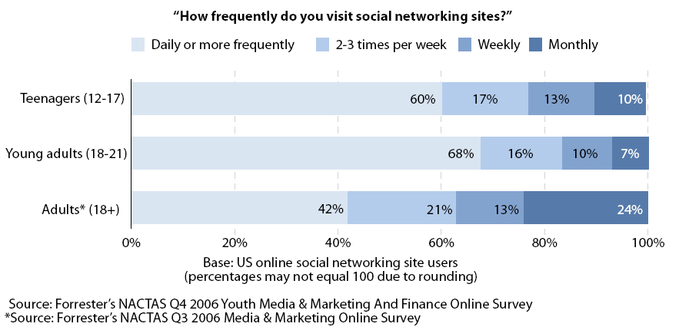
Social Network Usage
Notes:
CTIA: Mobile social networking blooms
Apr 2, 2008 2:29 PM, By Sarah Reedy
more on the topic
More Related Articles
Mobile social networking companies enter the U.S. market with new ideas, new audiences LAS VEGAS--Less than six months after Research In Motion (RIM) launched its Facebook-for-BlackBerry smartphone application at October’s CTIA conference, the company is announcing at this week’s show that the application has been downloaded 1 million times. With explosive growth like this, it is becoming harder to dismiss mobile social networking as a fad. According to Frost and Sullivan forecasts, application revenues from on-deck mobile social networking services are expected to reach $412.1 million in 2012, up from $57.4 million in 2007. As such, many companies at CTIA this week are looking to find their niche in the United States with different ideas of whom they want in their networks.
While Facebook and MySpace mobile applications are targeted at high-end smartphones like the BlackBerry and the iPhone, a sizable community of lower end, Web-enabled handset users are looking to network as well. Addressing this mobile-only market already burgeoning in developing countries, Singapore-based BuzzCity announced its entrance into the U.S. market at CTIA this week. On a global basis, the communication company has built the largest wireless-only community, myGamma, based on an off-portal, ad-supported business model. The company serves 1 billion ads per month.
To reach BuzzCity’s two audiences, the newly connected emerging middle class in developing markets and the blue collar sector in developed regions like the U.S., the user interface is simple and the community’s focus is centered on vanity and friendship. Users increase their status amongst peers and seek positive reviews and virtual gifts. According to CEO K.F. Lai, this desire for social communication and “status building” amongst wireless Internet users is driving BuzzCity’s niche market growth.
“We do see throughout our community and the network a trend that we believe will be replicated in the U.S. in terms of blue collar means to access the Internet through a cell phone,” Lai said. “Facebook Mobile is an extension of an online site, a value-added service. Their mobile site doesn’t make sense if you don’t have a profile online. Our site is designed for the mobile only.”
BuzzCity is entering an already saturated mobile social networking marketplace in the U.S. occupied by new mobile-focused startups, software makers and PC veterans taking their networks mobile. A majority of existing social communities are based on finding new friends to interact with, a trend that bluepulse CEO and founder Ben Keighran said doesn’t make sense on a user’s most personal communication device, the mobile phone. Hoping to attract an audience seeking enhanced communication with existing friends, 14-month old bluepulse is also trying its hand in the U.S. market. The company has already claimed the title of largest mobile social messenger, delivering 150 million messages per month. At CTIA this week, it is announcing new features to the service as well as the appointment of Google veteran Christopher Nguyen as CTO and VP of engineering.
The new features include friend-importing from Webmail services, so that the user can invite friends to participate or opt to receive email updates in lieu of mobile notifications, daily summary notifications of bluepulse activity and a set of new emoticons for users to express themselves through bluepulse messages. Keighran, who moved from Australia to Silicon Valley to grow the startup, said bluepulse is focused on turning the mobile phone into a tool for broadcasting information in a way that viewers can passively view at their leisure – like text messaging on steroids, Keighran said.
“Communication can be powerful when it is between two people, but explosive when you’re talking groups,” he said, adding that bluepulse makes communication more efficient in the same way search makes browsing more efficient.
Social networking services are coming from ancillary technology providers entering the market at unique angles as well. Mobile phone backup service provider FusionOne this week announced it has inked a deal with Qualcomm to license its MightyBackup application transfer client server module. FusionOne CEO Mike Mulica said that when customers are faced with the option of re-downloading their licensed applications when they upgrade or change their hardware, they often won’t do it. According to FusionOne surveys, only 13% repurchase some or all of their licensed content when they replace their mobile phone. With the MightyBackup technology, any BREW operator can now migrate and backup a consumer’s subscriptions and applications to a new device, thus retaining revenue that might otherwise have been lost.
Technologies like FusionOne’s also offer the carrier an opportunity to build a social networking community from a consumer’s mobile content. Things like ringtones, photos, games and contacts can also be ported to a Web interface that allows the consumer to view and interact with the content.
“You can leverage the content into a lot of different social networking environments,” Mulica said. “One of the things that’s really cool about this is people are just understanding that the mobile phone address book is one of the richest, social network databases available…I think we are at 600 million contacts in people’s cell phones that are being backed up through their address book backup. As a result, it is a gigantic social networking database that can be interesting a lot of different ways. We think it’s the largest social network database that exists on the planet.”

Slide 20
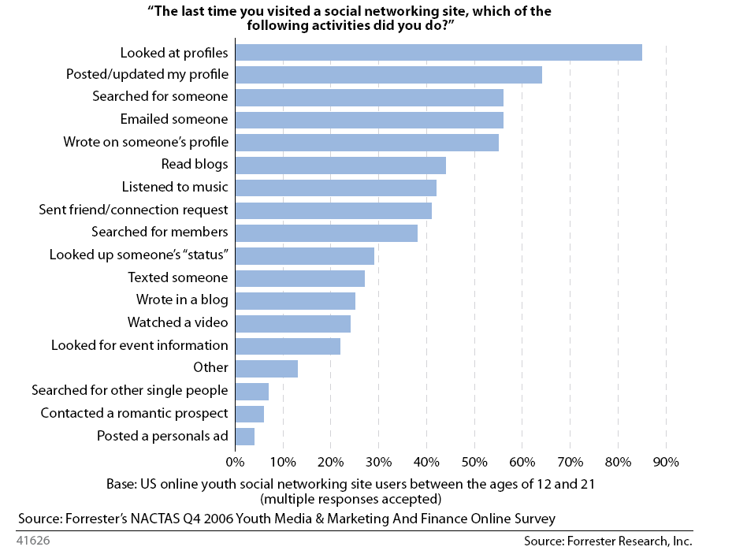
Social Network Activities
Notes:
CTIA: Mobile social networking blooms
Apr 2, 2008 2:29 PM, By Sarah Reedy
more on the topic
More Related Articles
Mobile social networking companies enter the U.S. market with new ideas, new audiences LAS VEGAS--Less than six months after Research In Motion (RIM) launched its Facebook-for-BlackBerry smartphone application at October’s CTIA conference, the company is announcing at this week’s show that the application has been downloaded 1 million times. With explosive growth like this, it is becoming harder to dismiss mobile social networking as a fad. According to Frost and Sullivan forecasts, application revenues from on-deck mobile social networking services are expected to reach $412.1 million in 2012, up from $57.4 million in 2007. As such, many companies at CTIA this week are looking to find their niche in the United States with different ideas of whom they want in their networks.
While Facebook and MySpace mobile applications are targeted at high-end smartphones like the BlackBerry and the iPhone, a sizable community of lower end, Web-enabled handset users are looking to network as well. Addressing this mobile-only market already burgeoning in developing countries, Singapore-based BuzzCity announced its entrance into the U.S. market at CTIA this week. On a global basis, the communication company has built the largest wireless-only community, myGamma, based on an off-portal, ad-supported business model. The company serves 1 billion ads per month.
To reach BuzzCity’s two audiences, the newly connected emerging middle class in developing markets and the blue collar sector in developed regions like the U.S., the user interface is simple and the community’s focus is centered on vanity and friendship. Users increase their status amongst peers and seek positive reviews and virtual gifts. According to CEO K.F. Lai, this desire for social communication and “status building” amongst wireless Internet users is driving BuzzCity’s niche market growth.
“We do see throughout our community and the network a trend that we believe will be replicated in the U.S. in terms of blue collar means to access the Internet through a cell phone,” Lai said. “Facebook Mobile is an extension of an online site, a value-added service. Their mobile site doesn’t make sense if you don’t have a profile online. Our site is designed for the mobile only.”
BuzzCity is entering an already saturated mobile social networking marketplace in the U.S. occupied by new mobile-focused startups, software makers and PC veterans taking their networks mobile. A majority of existing social communities are based on finding new friends to interact with, a trend that bluepulse CEO and founder Ben Keighran said doesn’t make sense on a user’s most personal communication device, the mobile phone. Hoping to attract an audience seeking enhanced communication with existing friends, 14-month old bluepulse is also trying its hand in the U.S. market. The company has already claimed the title of largest mobile social messenger, delivering 150 million messages per month. At CTIA this week, it is announcing new features to the service as well as the appointment of Google veteran Christopher Nguyen as CTO and VP of engineering.
The new features include friend-importing from Webmail services, so that the user can invite friends to participate or opt to receive email updates in lieu of mobile notifications, daily summary notifications of bluepulse activity and a set of new emoticons for users to express themselves through bluepulse messages. Keighran, who moved from Australia to Silicon Valley to grow the startup, said bluepulse is focused on turning the mobile phone into a tool for broadcasting information in a way that viewers can passively view at their leisure – like text messaging on steroids, Keighran said.
“Communication can be powerful when it is between two people, but explosive when you’re talking groups,” he said, adding that bluepulse makes communication more efficient in the same way search makes browsing more efficient.
Social networking services are coming from ancillary technology providers entering the market at unique angles as well. Mobile phone backup service provider FusionOne this week announced it has inked a deal with Qualcomm to license its MightyBackup application transfer client server module. FusionOne CEO Mike Mulica said that when customers are faced with the option of re-downloading their licensed applications when they upgrade or change their hardware, they often won’t do it. According to FusionOne surveys, only 13% repurchase some or all of their licensed content when they replace their mobile phone. With the MightyBackup technology, any BREW operator can now migrate and backup a consumer’s subscriptions and applications to a new device, thus retaining revenue that might otherwise have been lost.
Technologies like FusionOne’s also offer the carrier an opportunity to build a social networking community from a consumer’s mobile content. Things like ringtones, photos, games and contacts can also be ported to a Web interface that allows the consumer to view and interact with the content.
“You can leverage the content into a lot of different social networking environments,” Mulica said. “One of the things that’s really cool about this is people are just understanding that the mobile phone address book is one of the richest, social network databases available…I think we are at 600 million contacts in people’s cell phones that are being backed up through their address book backup. As a result, it is a gigantic social networking database that can be interesting a lot of different ways. We think it’s the largest social network database that exists on the planet.”

Slide 21
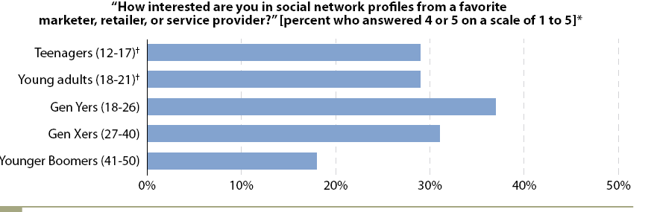
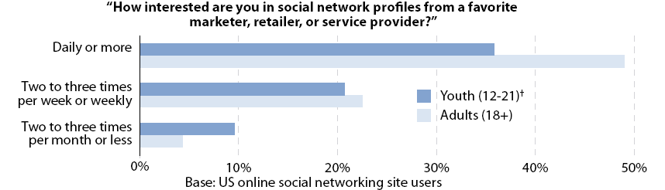
Social Networks for Marketing
Notes:
CTIA: Mobile social networking blooms
Apr 2, 2008 2:29 PM, By Sarah Reedy
more on the topic
More Related Articles
Mobile social networking companies enter the U.S. market with new ideas, new audiences LAS VEGAS--Less than six months after Research In Motion (RIM) launched its Facebook-for-BlackBerry smartphone application at October’s CTIA conference, the company is announcing at this week’s show that the application has been downloaded 1 million times. With explosive growth like this, it is becoming harder to dismiss mobile social networking as a fad. According to Frost and Sullivan forecasts, application revenues from on-deck mobile social networking services are expected to reach $412.1 million in 2012, up from $57.4 million in 2007. As such, many companies at CTIA this week are looking to find their niche in the United States with different ideas of whom they want in their networks.
While Facebook and MySpace mobile applications are targeted at high-end smartphones like the BlackBerry and the iPhone, a sizable community of lower end, Web-enabled handset users are looking to network as well. Addressing this mobile-only market already burgeoning in developing countries, Singapore-based BuzzCity announced its entrance into the U.S. market at CTIA this week. On a global basis, the communication company has built the largest wireless-only community, myGamma, based on an off-portal, ad-supported business model. The company serves 1 billion ads per month.
To reach BuzzCity’s two audiences, the newly connected emerging middle class in developing markets and the blue collar sector in developed regions like the U.S., the user interface is simple and the community’s focus is centered on vanity and friendship. Users increase their status amongst peers and seek positive reviews and virtual gifts. According to CEO K.F. Lai, this desire for social communication and “status building” amongst wireless Internet users is driving BuzzCity’s niche market growth.
“We do see throughout our community and the network a trend that we believe will be replicated in the U.S. in terms of blue collar means to access the Internet through a cell phone,” Lai said. “Facebook Mobile is an extension of an online site, a value-added service. Their mobile site doesn’t make sense if you don’t have a profile online. Our site is designed for the mobile only.”
BuzzCity is entering an already saturated mobile social networking marketplace in the U.S. occupied by new mobile-focused startups, software makers and PC veterans taking their networks mobile. A majority of existing social communities are based on finding new friends to interact with, a trend that bluepulse CEO and founder Ben Keighran said doesn’t make sense on a user’s most personal communication device, the mobile phone. Hoping to attract an audience seeking enhanced communication with existing friends, 14-month old bluepulse is also trying its hand in the U.S. market. The company has already claimed the title of largest mobile social messenger, delivering 150 million messages per month. At CTIA this week, it is announcing new features to the service as well as the appointment of Google veteran Christopher Nguyen as CTO and VP of engineering.
The new features include friend-importing from Webmail services, so that the user can invite friends to participate or opt to receive email updates in lieu of mobile notifications, daily summary notifications of bluepulse activity and a set of new emoticons for users to express themselves through bluepulse messages. Keighran, who moved from Australia to Silicon Valley to grow the startup, said bluepulse is focused on turning the mobile phone into a tool for broadcasting information in a way that viewers can passively view at their leisure – like text messaging on steroids, Keighran said.
“Communication can be powerful when it is between two people, but explosive when you’re talking groups,” he said, adding that bluepulse makes communication more efficient in the same way search makes browsing more efficient.
Social networking services are coming from ancillary technology providers entering the market at unique angles as well. Mobile phone backup service provider FusionOne this week announced it has inked a deal with Qualcomm to license its MightyBackup application transfer client server module. FusionOne CEO Mike Mulica said that when customers are faced with the option of re-downloading their licensed applications when they upgrade or change their hardware, they often won’t do it. According to FusionOne surveys, only 13% repurchase some or all of their licensed content when they replace their mobile phone. With the MightyBackup technology, any BREW operator can now migrate and backup a consumer’s subscriptions and applications to a new device, thus retaining revenue that might otherwise have been lost.
Technologies like FusionOne’s also offer the carrier an opportunity to build a social networking community from a consumer’s mobile content. Things like ringtones, photos, games and contacts can also be ported to a Web interface that allows the consumer to view and interact with the content.
“You can leverage the content into a lot of different social networking environments,” Mulica said. “One of the things that’s really cool about this is people are just understanding that the mobile phone address book is one of the richest, social network databases available…I think we are at 600 million contacts in people’s cell phones that are being backed up through their address book backup. As a result, it is a gigantic social networking database that can be interesting a lot of different ways. We think it’s the largest social network database that exists on the planet.”

Slide 22
Social Networks Imitators
Notes:
CTIA: Mobile social networking blooms
Apr 2, 2008 2:29 PM, By Sarah Reedy
more on the topic
More Related Articles
Mobile social networking companies enter the U.S. market with new ideas, new audiences LAS VEGAS--Less than six months after Research In Motion (RIM) launched its Facebook-for-BlackBerry smartphone application at October’s CTIA conference, the company is announcing at this week’s show that the application has been downloaded 1 million times. With explosive growth like this, it is becoming harder to dismiss mobile social networking as a fad. According to Frost and Sullivan forecasts, application revenues from on-deck mobile social networking services are expected to reach $412.1 million in 2012, up from $57.4 million in 2007. As such, many companies at CTIA this week are looking to find their niche in the United States with different ideas of whom they want in their networks.
While Facebook and MySpace mobile applications are targeted at high-end smartphones like the BlackBerry and the iPhone, a sizable community of lower end, Web-enabled handset users are looking to network as well. Addressing this mobile-only market already burgeoning in developing countries, Singapore-based BuzzCity announced its entrance into the U.S. market at CTIA this week. On a global basis, the communication company has built the largest wireless-only community, myGamma, based on an off-portal, ad-supported business model. The company serves 1 billion ads per month.
To reach BuzzCity’s two audiences, the newly connected emerging middle class in developing markets and the blue collar sector in developed regions like the U.S., the user interface is simple and the community’s focus is centered on vanity and friendship. Users increase their status amongst peers and seek positive reviews and virtual gifts. According to CEO K.F. Lai, this desire for social communication and “status building” amongst wireless Internet users is driving BuzzCity’s niche market growth.
“We do see throughout our community and the network a trend that we believe will be replicated in the U.S. in terms of blue collar means to access the Internet through a cell phone,” Lai said. “Facebook Mobile is an extension of an online site, a value-added service. Their mobile site doesn’t make sense if you don’t have a profile online. Our site is designed for the mobile only.”
BuzzCity is entering an already saturated mobile social networking marketplace in the U.S. occupied by new mobile-focused startups, software makers and PC veterans taking their networks mobile. A majority of existing social communities are based on finding new friends to interact with, a trend that bluepulse CEO and founder Ben Keighran said doesn’t make sense on a user’s most personal communication device, the mobile phone. Hoping to attract an audience seeking enhanced communication with existing friends, 14-month old bluepulse is also trying its hand in the U.S. market. The company has already claimed the title of largest mobile social messenger, delivering 150 million messages per month. At CTIA this week, it is announcing new features to the service as well as the appointment of Google veteran Christopher Nguyen as CTO and VP of engineering.
The new features include friend-importing from Webmail services, so that the user can invite friends to participate or opt to receive email updates in lieu of mobile notifications, daily summary notifications of bluepulse activity and a set of new emoticons for users to express themselves through bluepulse messages. Keighran, who moved from Australia to Silicon Valley to grow the startup, said bluepulse is focused on turning the mobile phone into a tool for broadcasting information in a way that viewers can passively view at their leisure – like text messaging on steroids, Keighran said.
“Communication can be powerful when it is between two people, but explosive when you’re talking groups,” he said, adding that bluepulse makes communication more efficient in the same way search makes browsing more efficient.
Social networking services are coming from ancillary technology providers entering the market at unique angles as well. Mobile phone backup service provider FusionOne this week announced it has inked a deal with Qualcomm to license its MightyBackup application transfer client server module. FusionOne CEO Mike Mulica said that when customers are faced with the option of re-downloading their licensed applications when they upgrade or change their hardware, they often won’t do it. According to FusionOne surveys, only 13% repurchase some or all of their licensed content when they replace their mobile phone. With the MightyBackup technology, any BREW operator can now migrate and backup a consumer’s subscriptions and applications to a new device, thus retaining revenue that might otherwise have been lost.
Technologies like FusionOne’s also offer the carrier an opportunity to build a social networking community from a consumer’s mobile content. Things like ringtones, photos, games and contacts can also be ported to a Web interface that allows the consumer to view and interact with the content.
“You can leverage the content into a lot of different social networking environments,” Mulica said. “One of the things that’s really cool about this is people are just understanding that the mobile phone address book is one of the richest, social network databases available…I think we are at 600 million contacts in people’s cell phones that are being backed up through their address book backup. As a result, it is a gigantic social networking database that can be interesting a lot of different ways. We think it’s the largest social network database that exists on the planet.”

Slide 23
Management & Leadership Team
Roy Shelton: Chief Executive Officer
Serial start-up to exit executive.
100% tech-orientated global career.
MBA graduate.
Andrew Doyle: Chief Operating/ Financial Officer
Serial start-up to exit executive.
100% tech-orientated global career.
Business degree graduate.
Anthony Nystrom: Chief Technical Architect
10 years in software development, mobile to enterprise.
Innovative, exceptionally creative technology evangelist.
BSc in Computer Science & Mathematics, BA in Biology & Anthropology.
Gary Nystrom: Senior Developer
30 year career as software developer and analyst.
Experienced developer for world’s largest financial institutions, especially high security.
BSc in Chemistry & Mathematics, BA in Health & Actuary Sciences.
Lawrence Botley: Lead Developer
8 years multi-faceted development with telecoms focus.
4 years development experience with multi-platform technologies.
BSc in Artificial Intelligence & Computer Science, MSc in IT ecommerce.

Slide 24
Advisory Panel
John Cronin
Serial CEO with over 30 years software experience
Chairman of Cambridge Broadband and Bailey Fisher
Non Executive Director at Subex Azure, Netsource and I2
Steve Verrall
FSTE 100 Chairman of +£100m software company
Major contacts and experience
Equity investor in Next2Friends
Richard Ash
CEO of Green Room Retail
Major contacts and experience in PR and partnership development
Known key Next2Friends personnel for 8+ years

Slide 25
The Choice Operators and Customers Face
Partner with Next2Friends | Build it Yourself
Established community Proven customer experience No large capital investment Mutual brand credibility Proven model | High costs Different culture Scarce resources Slow to market

Slide 26
Contacts
Please direct all communications to:
Roy Shelton
Chief Executive Officer
roy@next2friends.com
+44 (0) 7977 237284

